Slide 1

https://sahibulsaif.wordpress.com/wisdom/bismillah-nature/

Slide 2
Logical database modeling
CSC271 – DATABASE SYSTEMS

Slide 3
Previous Lecture Overview

Slide 4
Today’s Lecture
In this lecture, you will learn:
Logical Database Modeling
Relational Model
Integrity Constraints

Slide 5
Logical Database Modeling
The process of transforming conceptual data model into a logical data model - one that is consistent and compatible with a specific type of database technology.
Conceptual data modeling: understanding the organization - getting the right requirements.
Logical database design: creating stable database structures.

Slide 6
Relational Model
Why Relational Model?
The one most commonly used in contemporary database applications.
Principles of logical database design for the relational model apply to the other logical models as well.
First introduced in 1970 by E. F. Codd
Today RDBMSs have become the dominant technology for database management.

Slide 7
Relational Model
The relational data model represents data in the form of relations (tables).
A relation is a named, two-dimensional table of data.
Each relation (or table) consists of a set of named columns and an arbitrary number of unnamed rows.
The word relation (in relational database) is NOT the same as the word relationship (in E-R model)
Shorthand notation: name of the relation is followed (in parentheses) by the names of the attributes in that relation.

Slide 8
Shorthand notation of a relation

Slide 9
Relations or Tables
Properties of relations
Each relation has a unique name.
An entry at the intersection of each row and column is atomic (or single valued).
There can be only one value associated with each attribute on a specific row of a table; no multivalued attributes are allowed in a relation.
Each row is unique; no two rows in a relation can be identical.

Slide 10
Relations or Tables
Properties of relations
Each attribute (or column) within a table has a unique name.
The sequence of columns (left to right) is insignificant. The order of the columns in a relation can be changed without changing the meaning or use of the relation.
The sequence of rows (top to bottom) is insignificant. As with columns, the order of the rows of a relation may be changed or stored in any sequence.

Slide 12
Relational Model
A Primary Key is an attribute or a combination of attributes that uniquely identifies each row in a relation.
Designate a primary key by underlining the attribute name(s).
Concept of a Primary key is related to the term ‘identifier’ in Conceptual Modeling.
A Composite Key is a primary key that consists of more than one attribute.
A Foreign Key is an attribute in a relation that serves as the primary key of another relation.

Slide 13
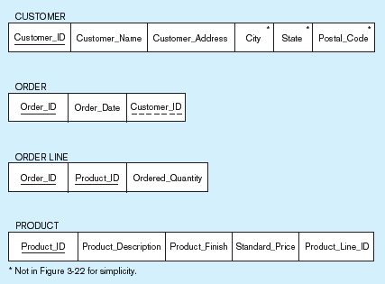
Primary Key
Foreign Key (implements 1:N relationship between customer and order)
Combined, these are a composite primary key (uniquely identifies the order line)…individually they are foreign keys (implement M:N relationship between order and product)

Slide 14
Integrity Constraints
Domain Constraints
All of the values that appear in a column of a relation must be from the same domain.
A domain is the set of values that may be assigned to an attribute.
Entity Integrity
No primary key attribute may be null. All primary key fields MUST have data

Slide 15
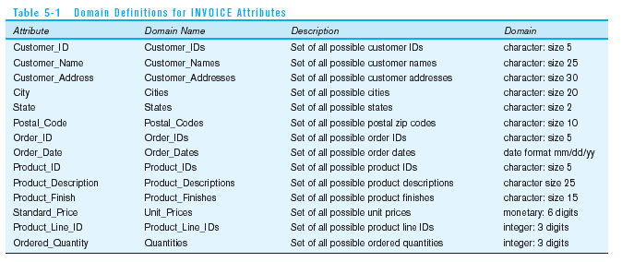
Domain definitions enforce domain integrity constraints

Slide 16
Referential Integrity–rule
Any foreign key value (on the relation of the many side) MUST match a primary key value in the relation of the one side. (Or the foreign key can be null)
For example: Delete Rules
Restrict–don’t allow delete of “parent” side if related rows exist in “dependent” side
Cascade–automatically delete “dependent” side rows that correspond with the “parent” side row to be deleted
Set-to-Null–set the foreign key in the dependent side to null if deleting from the parent side → not allowed for weak entities

Slide 17
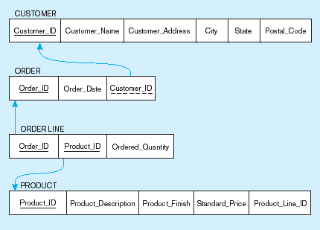
Referential integrity constraints
Referential integrity constraints are drawn via arrows from dependent to parent table

Slide 18
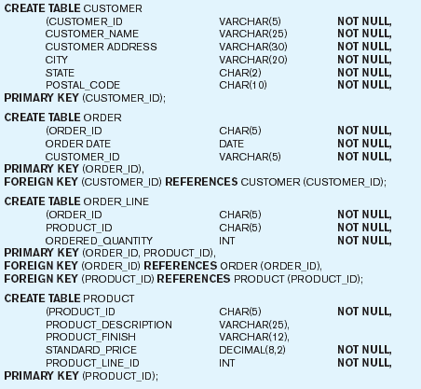
SQL table definitions
Referential integrity constraints are implemented with foreign key to primary key references

Slide 19

http://www.thomasformo.com/category/qa/

